Slide 1


DEXTERITY TECHSYS
Private Limited
“Driving the Skills for Innovative Solutions”
www.dexterityindia.com
Notes:
www.dexterityindia.com

Slide 2

WHO WE ARE?
ABOUT US
Dexterity TechSys was founded in 2011 with a view to provide ERP related services. We started our journey with Tally Software and later we introduced Marg ERP. Currently we are 5* Certified Partner for Tally and Marg and serving 3000+ customer and also have completed around 1600+ projects.
With a rich experience in the implementation of Enterprise business solutions in various ERP framework – offers complete solutions, which includes consultancy, design, development, implementation and training. We add value to productivity of our customers by bringing excellent understanding of their business processes, across the table.
www.dexterityindia.com
Notes:
www.dexterityindia.com

Slide 3





WHAT WE DO?
Tally ERP
Marg ERP
Accounting Services
Website Development
Mobile App
Sales/Services/
AMC
Corporate Training / implementation etc…
Sales/Services/
AMC
Corporate Training / implementation etc…
Maintaining Books of accounts, GST Returns and related services, System Implementation
Static Website / Dynamic Website/ E-Comm Websites
Android / IOS /Cross Platform Apps
www.dexterityindia.com
Notes:
www.dexterityindia.com

Slide 4
THE HISTORY
Company
Formation
Crossed 1000+ Customers
5* Tally
Certified Partner
Crossed 3000+ Customers
2012
2017
2011
2015
2019
Became Tally Integrated
&
Extender Partner
Partner for Tally
Partner for Marg ERP
www.dexterityindia.com
Notes:
www.dexterityindia.com

Slide 5
MISSION, VISION & PHILOSOPHY
MISSION
VISION
Philosophy
"To provide Affordable and Quality products to clients by adopting Innovative Technology"
To be a Market Leader in India with Excellence by Developing Innovative Solutions
Provide support and services to new and existing customers by addressing their pain areas with the help of consultation, training, implementation and customized
solutions
www.dexterityindia.com
Notes:
www.dexterityindia.com

Slide 6
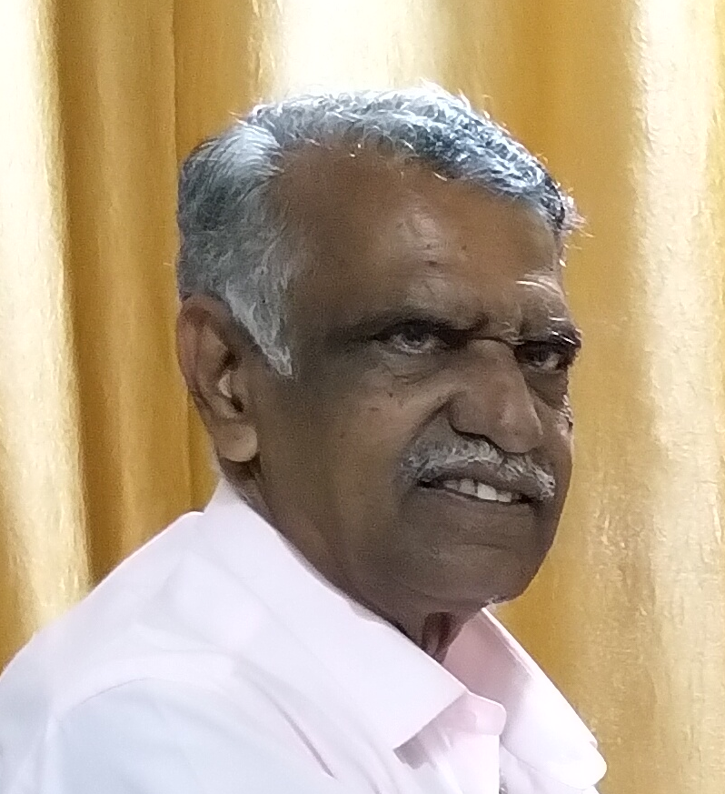
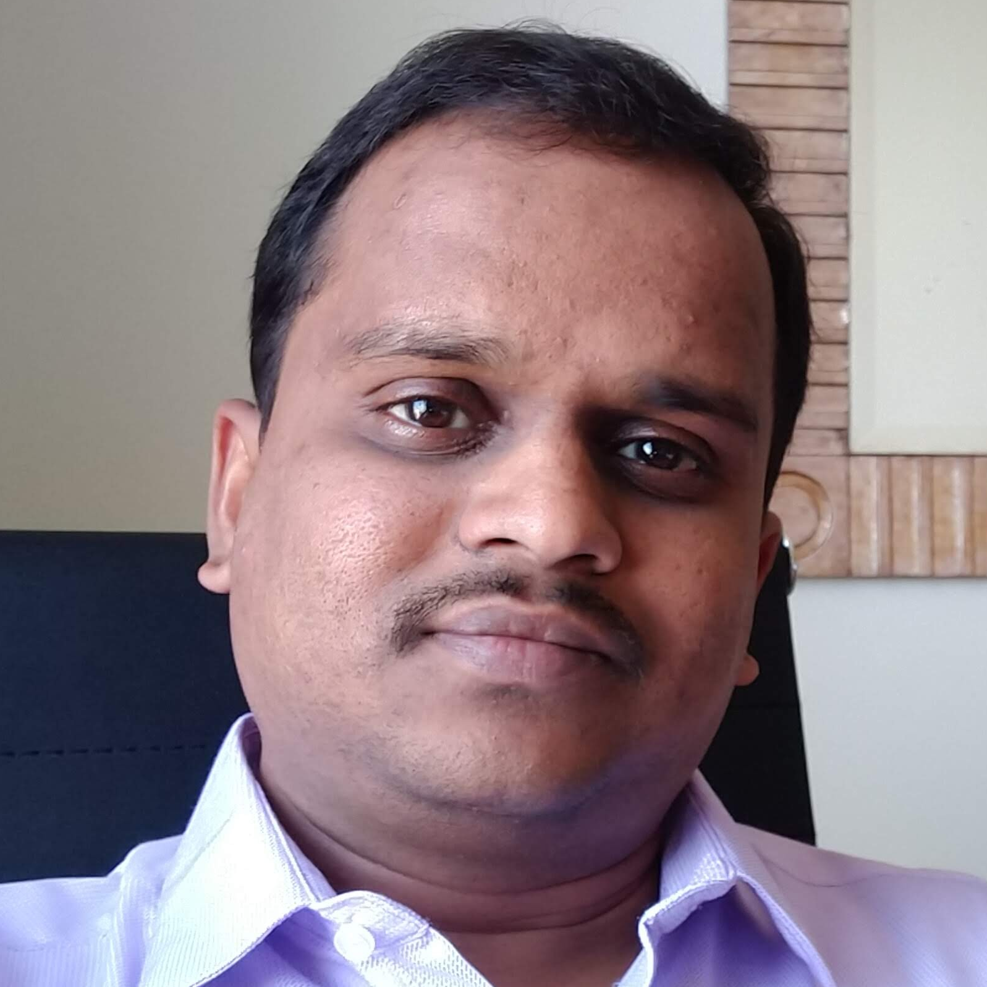
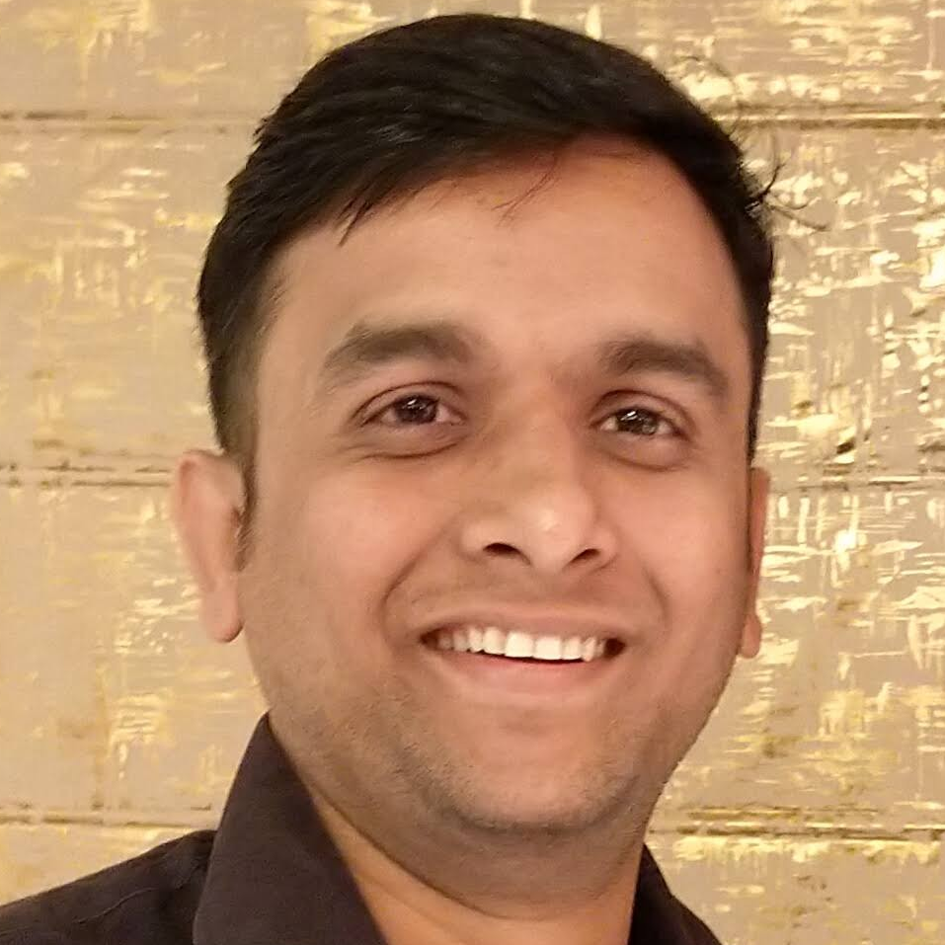



THE TEAM
D M Joshi
Sameer Deokar
Ramesh Bhatt
Founder Director
Founder Director
Director
dmjoshi@dexterityindia.in
7350001088
sameer@dexterityindia.in
7350000673
ramesh@dexterityindia.in
7030639044
www.dexterityindia.com
Notes:
www.dexterityindia.com

Slide 7
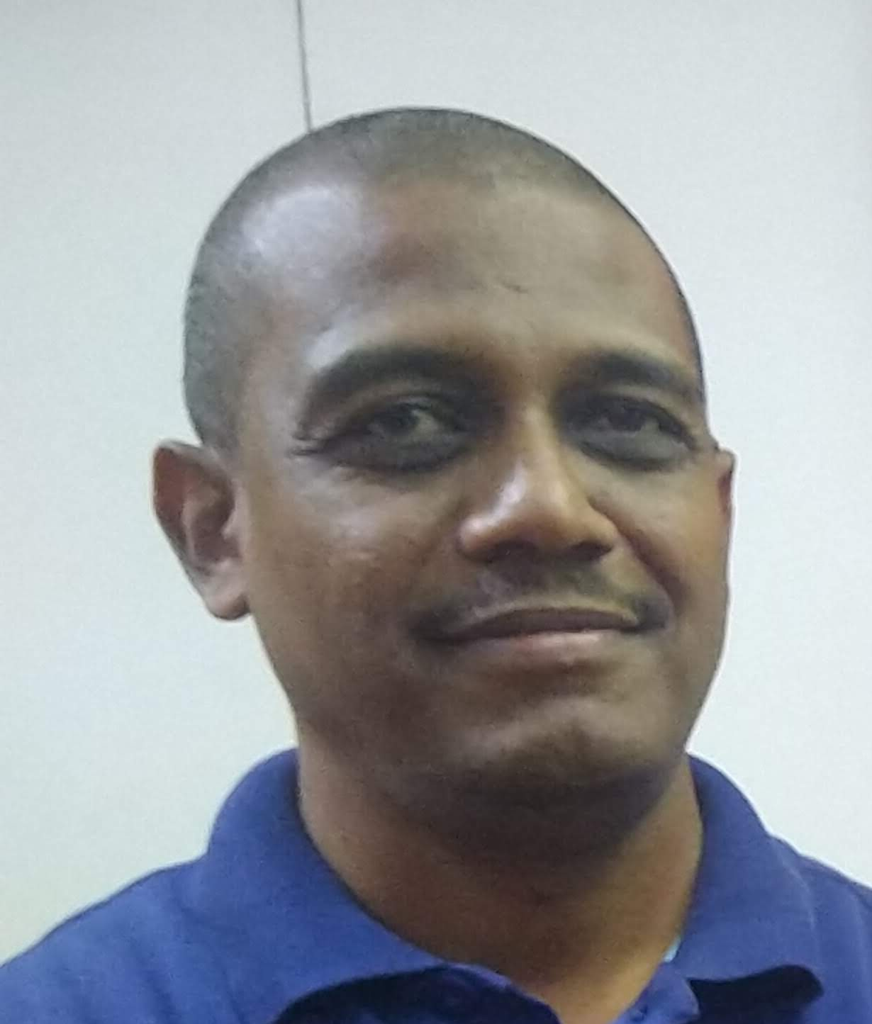
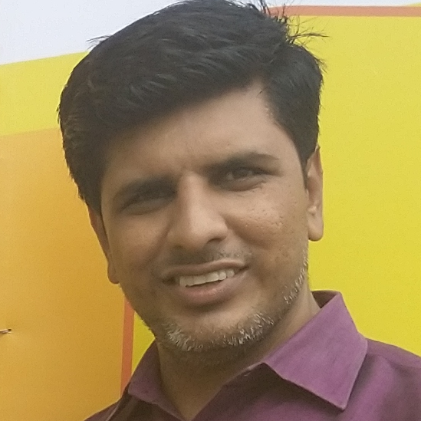
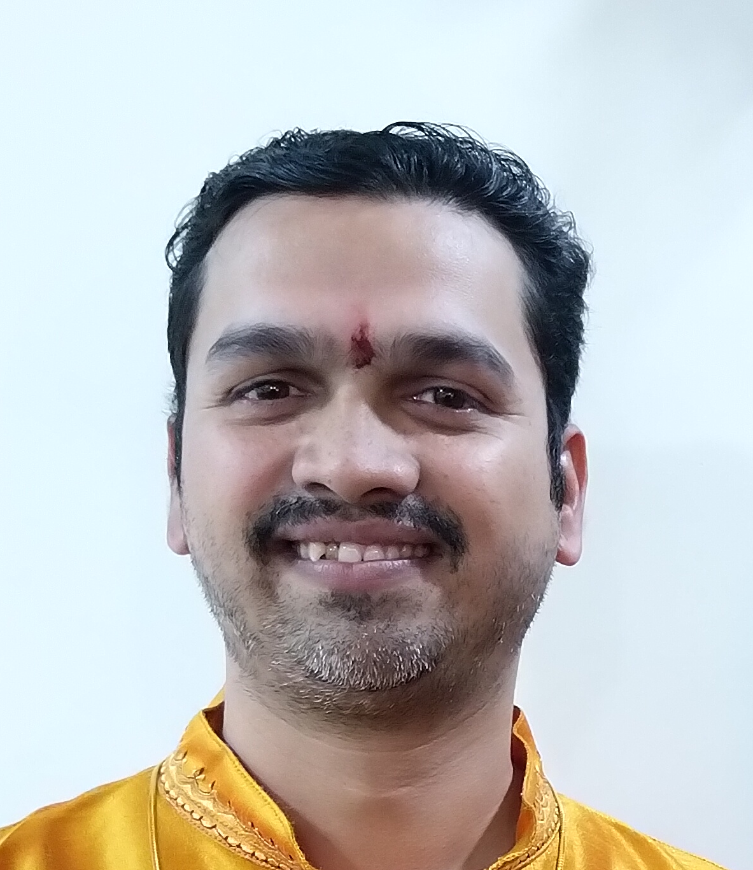
THE TEAM
Praful Patil
Prashant Rasne
Vishwesh Natu
Director
Director
Director
solutions@dexterityindia.in
7350001088
prashant@dexterityindia.in
7350001088
vishwesh@dexterityindia.in
7350001088
www.dexterityindia.com
Notes:
www.dexterityindia.com

Slide 8




KEYS TO SUCCESS
Team with 200+ years of Combined Experience
Right Solution approach due to exposure to variety of all types of Industrial Segments (Mfg/Trading/service), served by us till the date
Specialized team for Sales, Service & Development
Marketing Strategies aimed to build a solid base of loyal customers.
www.dexterityindia.com
Notes:
www.dexterityindia.com

Slide 9






Solutions for Tally
1
Paperless Office Solution
Material Requirement Planning
Document Tracking Solution for Tally.
Highest Selling Product
Useful for Manufacturing Industry
Handles Multi BOM level to generate MRP
2
DMS Integration with Tally
LR Solution
Solution for Automobile Industry
Ready for Maruti / Jeep / Fiat etc…
Solution for Transport Industry
Tracks each LR and its billing and related reporting
Housing Society Solution
Project ERP
Useful for Co-Operative Societies
Auto Billing Solution
Very useful solution for organizations involved in Projects
Provides better visibility of Profit & Loss of each project.
And Many Many More…
www.dexterityindia.com

Slide 10





Solutions from Marg
FMCG
HR Expert
Designed to handle all the needs of FMCG business
A revolutionary payroll software by Marg
Easily manage employees’ attendance, salary and payroll functions
Pharma Industry
Automobile Industry
A single/ multi-location Pharma Distribution Software for Stockists, Wholesalers, Distributors
Solution for Transport Industry
Tracks each LR and its billing and related reporting
Garment Industry
Manage inventory levels, get rid of over/under stock, alerts for non moving items, supplier wise best deals, discount & scheme management along with 1000’s of reports to run your Garment business wisely.
And Many Many More…
www.dexterityindia.com

Slide 11




Web / Mobile App
www.dexterityindia.com

Slide 12








Few Clientele…
www.dexterityindia.com
Notes:
www.dexterityindia.com

Slide 13








Few Clientele…
www.dexterityindia.com
Notes:
www.dexterityindia.com

Slide 14









Few Clientele…
www.dexterityindia.com
Notes:
www.dexterityindia.com

Slide 15

DEXTERITY TECHSYS
Private Limited
“Driving the Skills for Innovative Solutions”
Office No. 4&5, Shankar Chatra Apartment, CTS 575,
Opp. Kesari wada, Shaniwar Peth, Pune 411030
020-24499444 / 7350000673
contact@dexterityindia.in
www.dexterityindia.com
Notes:
www.dexterityindia.com

